Slide 1


Sprites & Node.js
Tech Loyalties

Slide 2

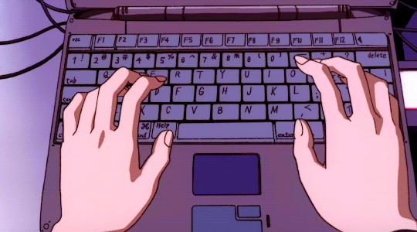
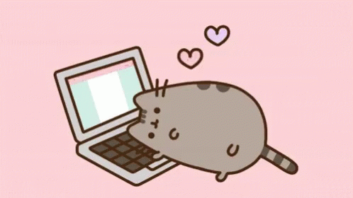
Implementation
Node.js
Sprites

Slide 3


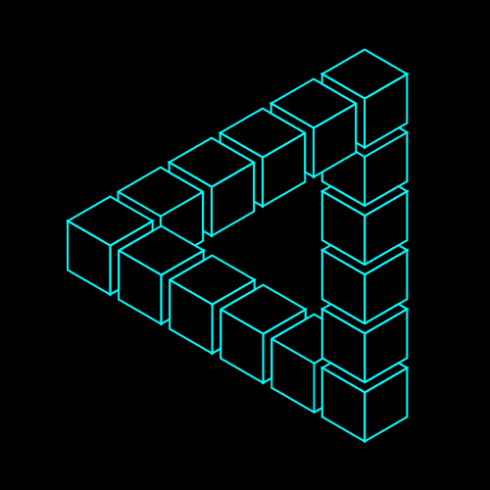
Benefits
Handles Simultaneous Requests
Game Animation
Scalable

Slide 4
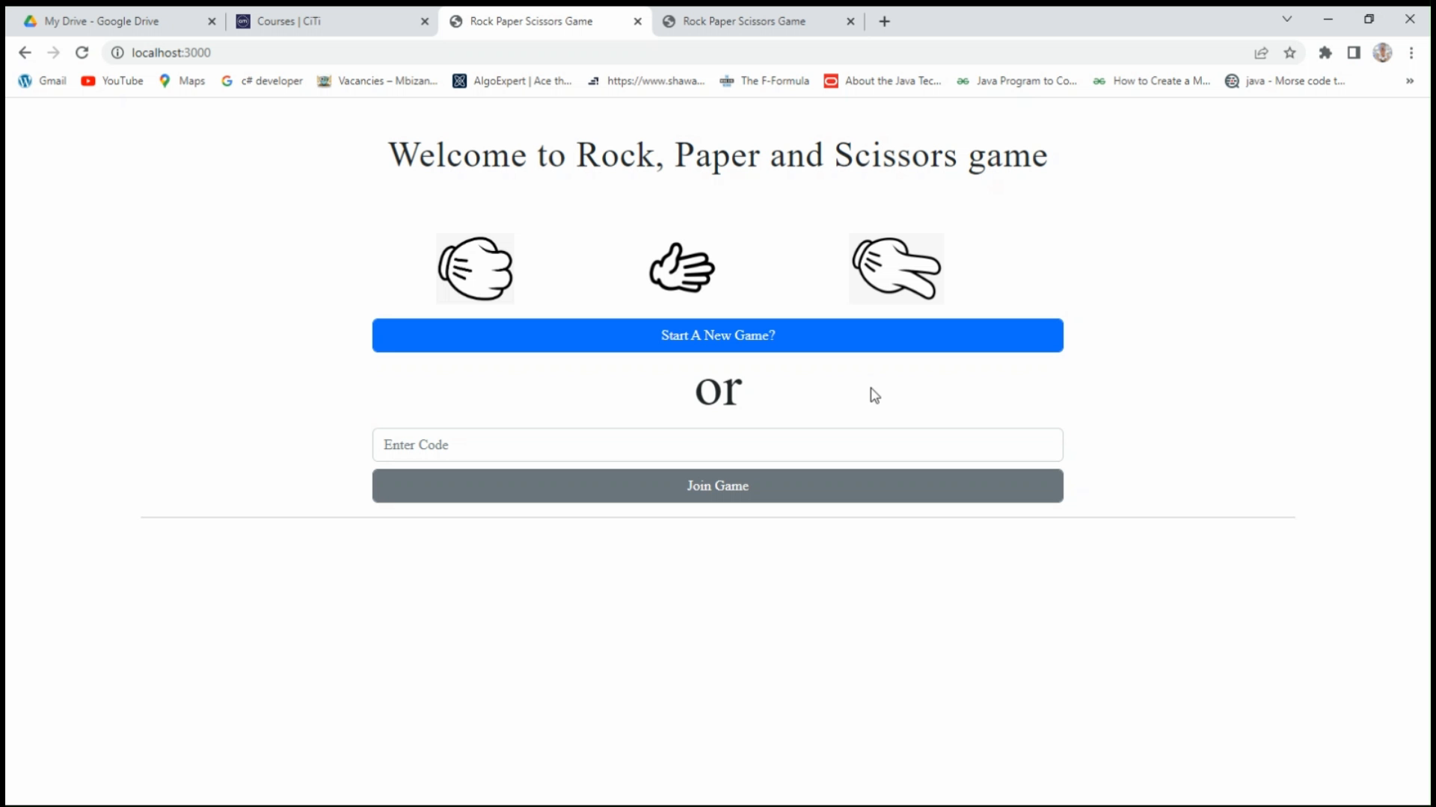
Rock Paper Scissors
Node JS
Express JS
Socket.IO

Slide 5
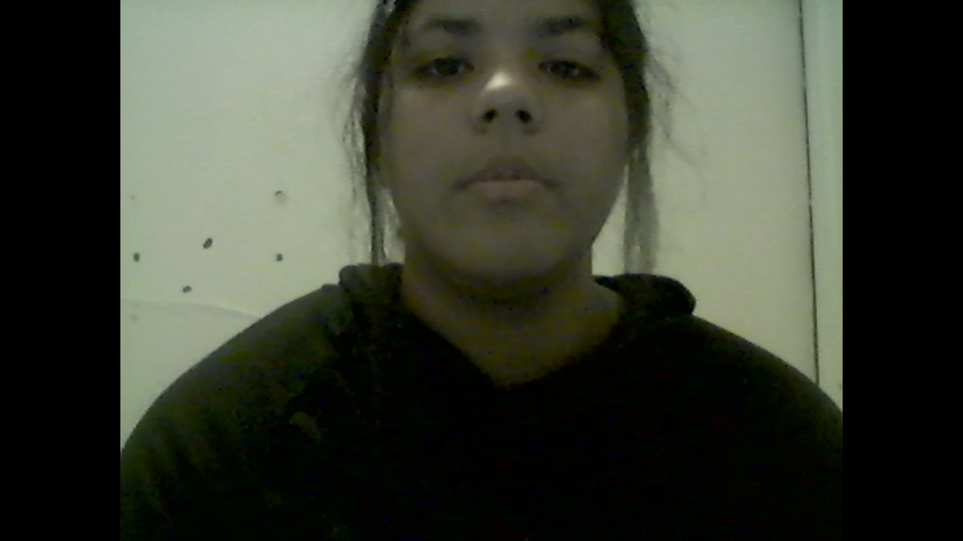
Sprites

Slide 6
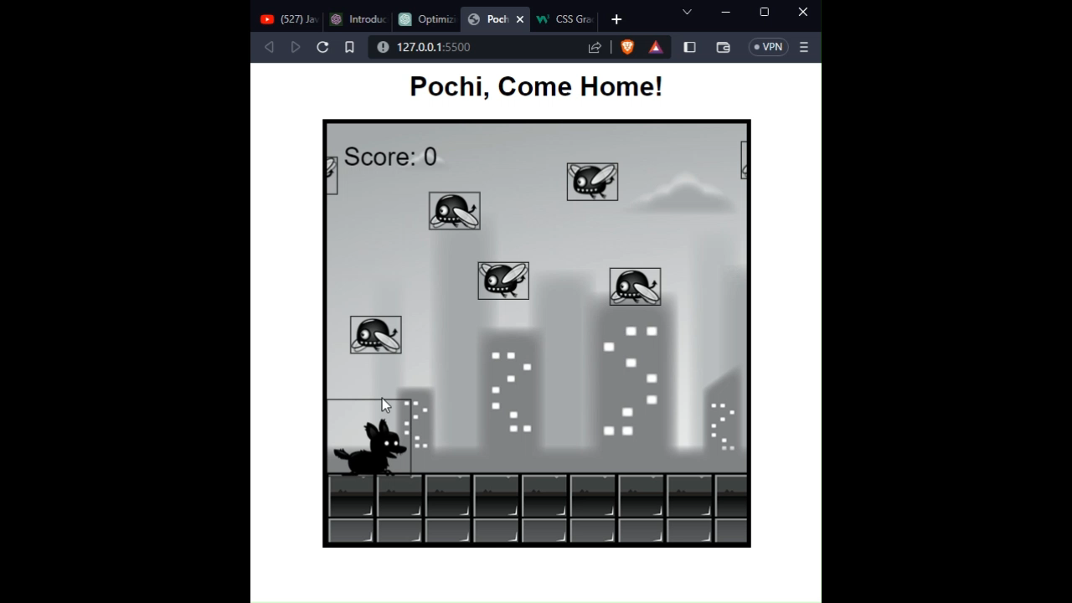
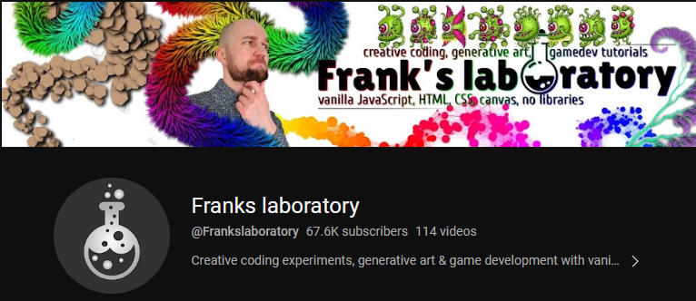
Pochi, Come Home!

Slide 7
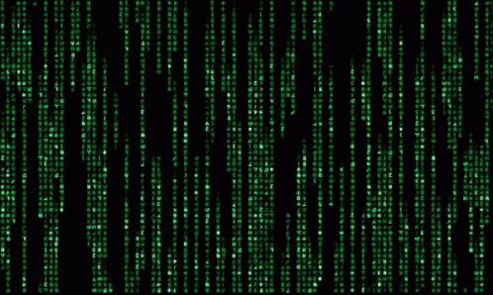
Well, we be on the internet now.
https://ryanisthebest-5aee9.web.app

Slide 8
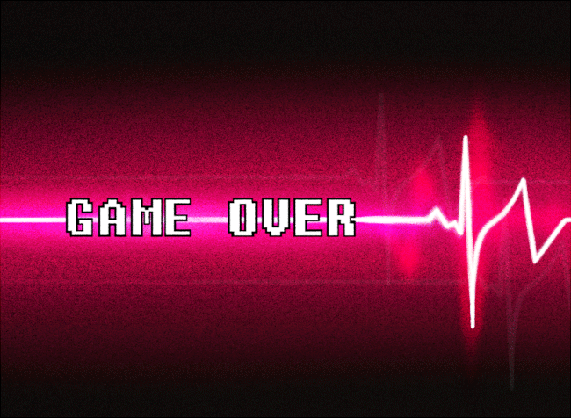

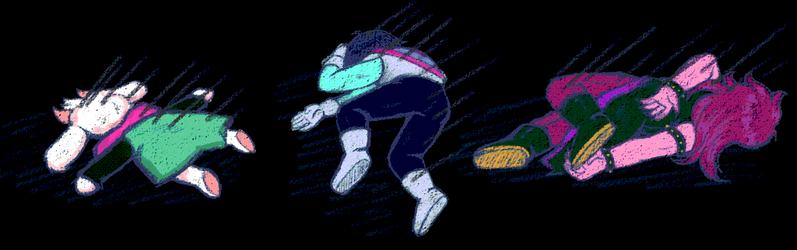
INSERT FOR QUESTIONS.

